Slide 1
Deep Learning Architecture
Cnn | RNN | lstm | Autoencoders | RBM | Recommendation Engines

Slide 2

How does a computer identify an image?

Slide 3
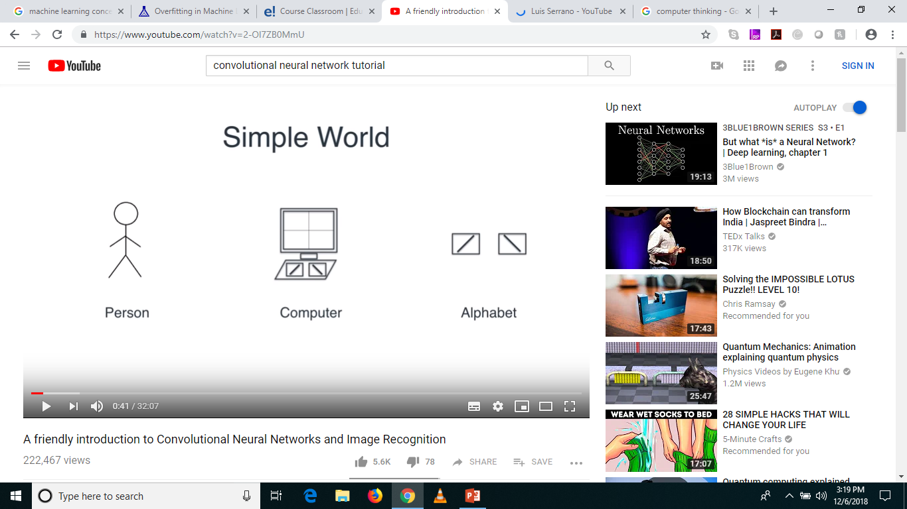
A Simple World

Slide 4
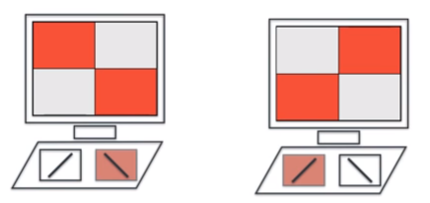
Using the Keyboard

Slide 5
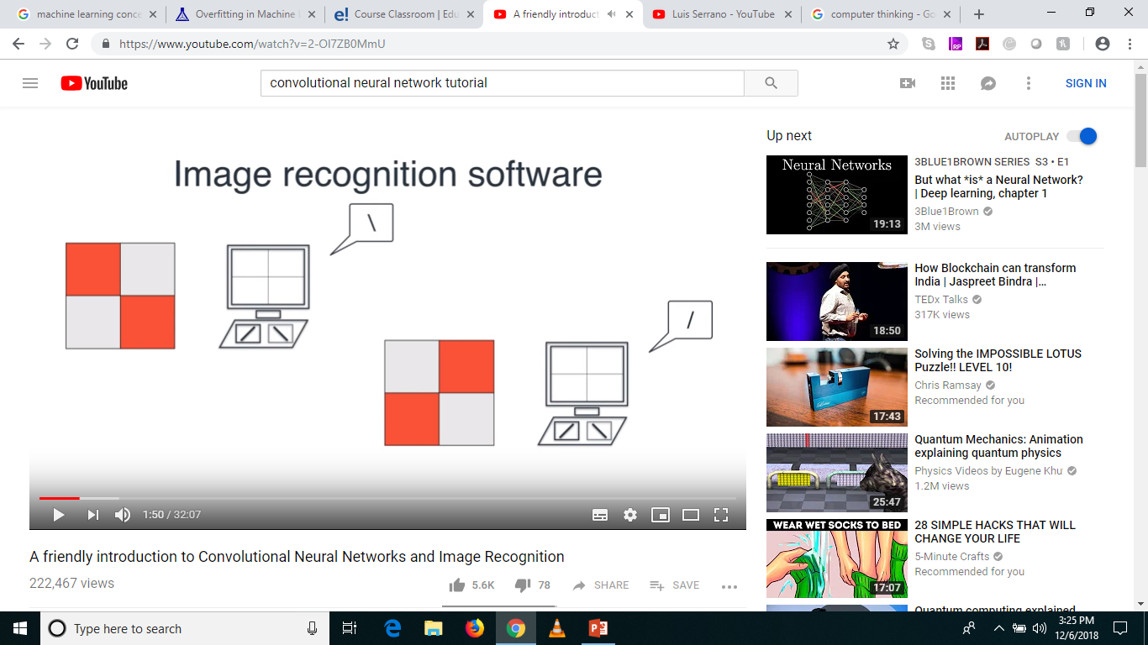

Let’s build an Image Recognition Classifer

Slide 6
What does a computer see? (Not images)
1
-1
-1
1
-1
1
1
-1
Filters

Slide 7
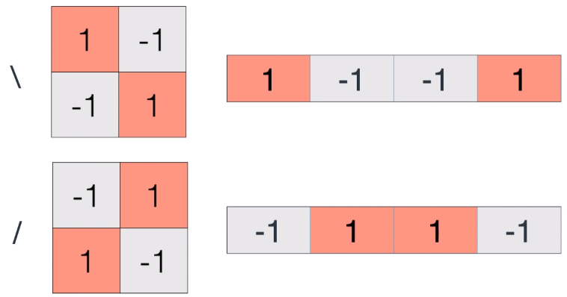
Really?

Slide 8
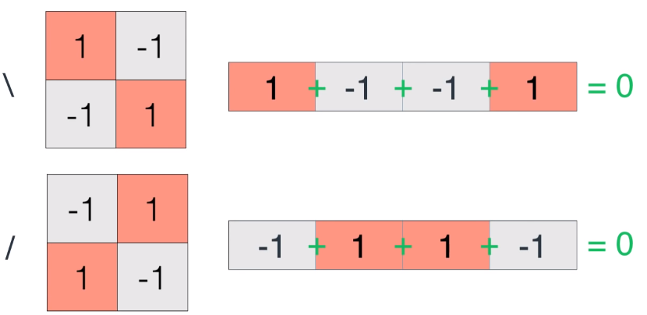

How to tell them apart! … Let’s Add!

Slide 9
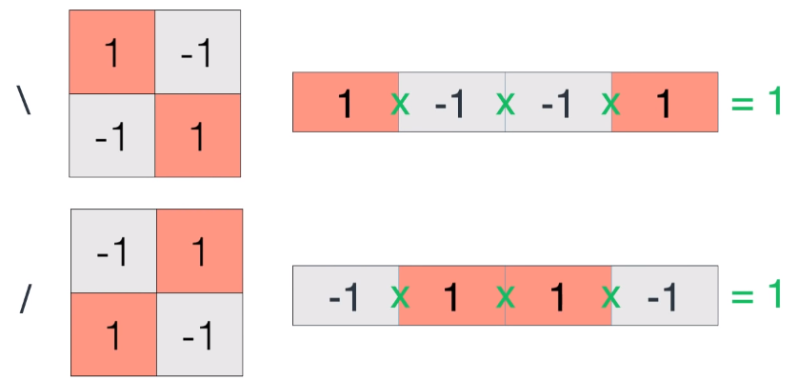
Let’s Multiply!

Slide 10
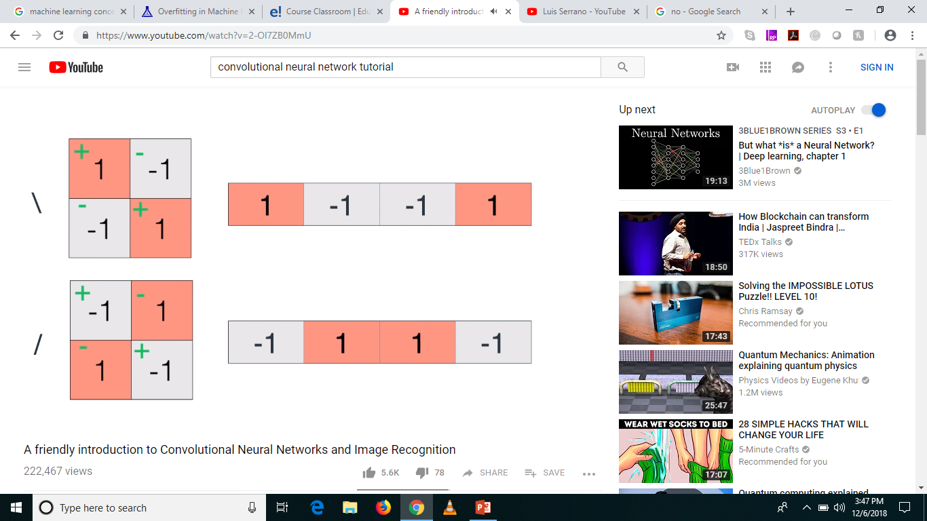

Best option

Slide 11


Let’s see if it works

Slide 12
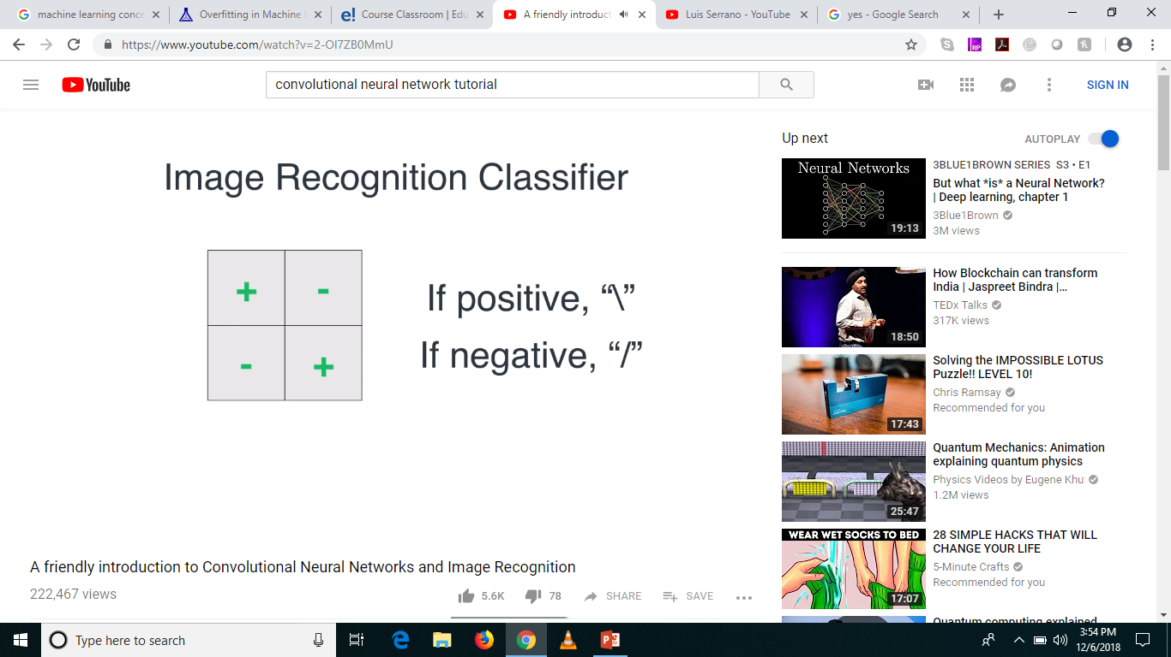
Yay! Our first Image Recognition Classifier!

Slide 13
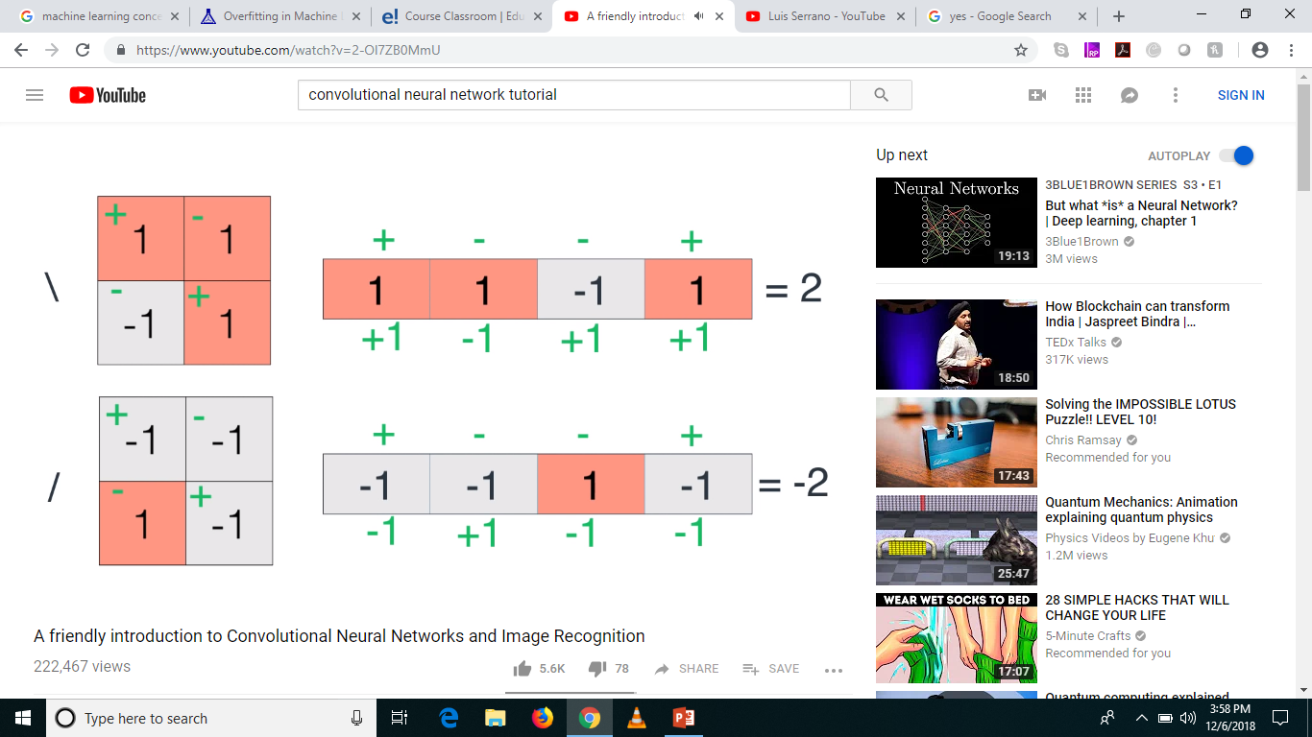
Is our rule generalized? Robust?

Slide 14
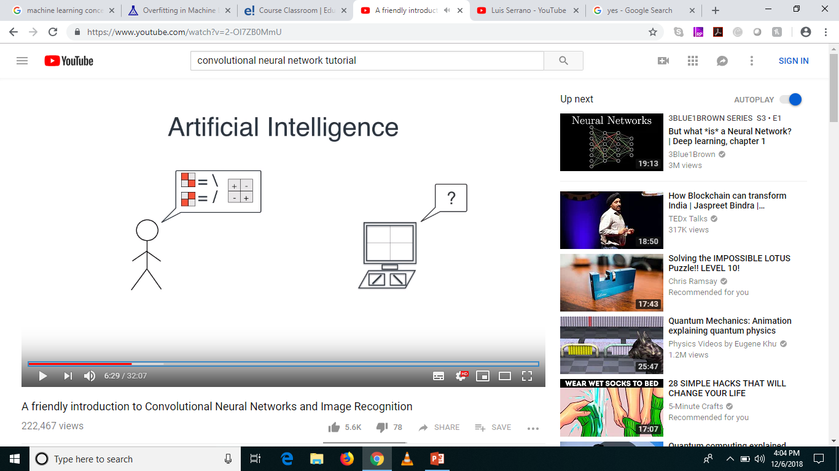
The problem!

Slide 15
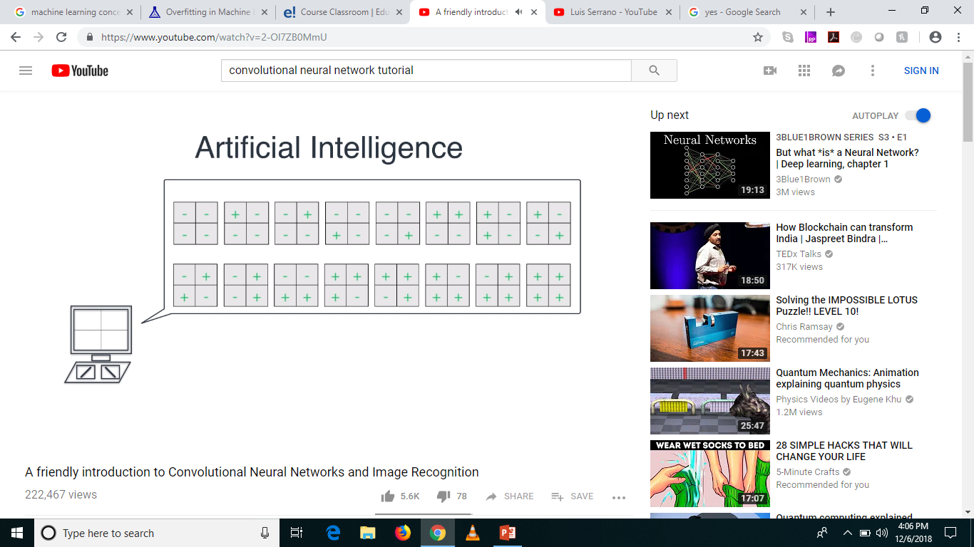
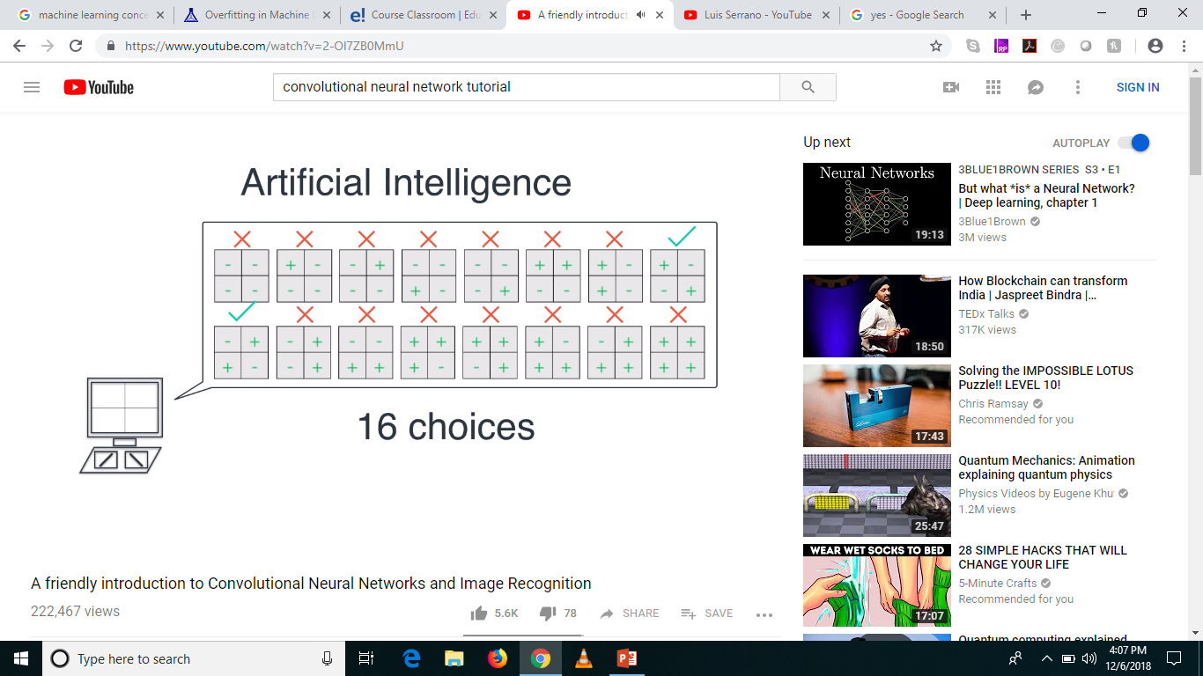
What can the computer do?

Slide 16
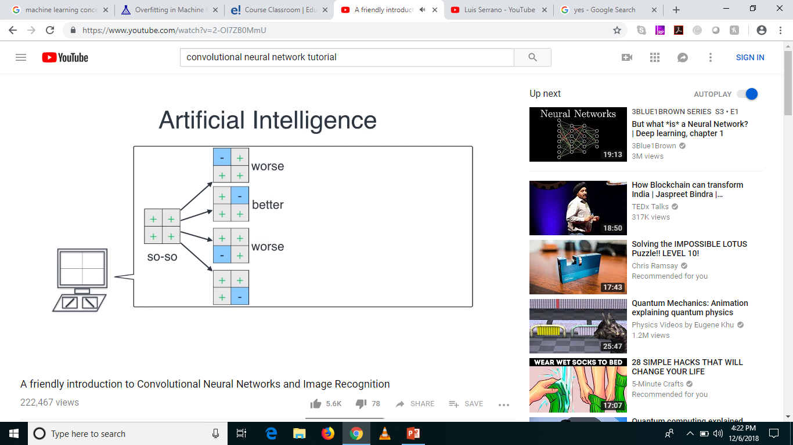

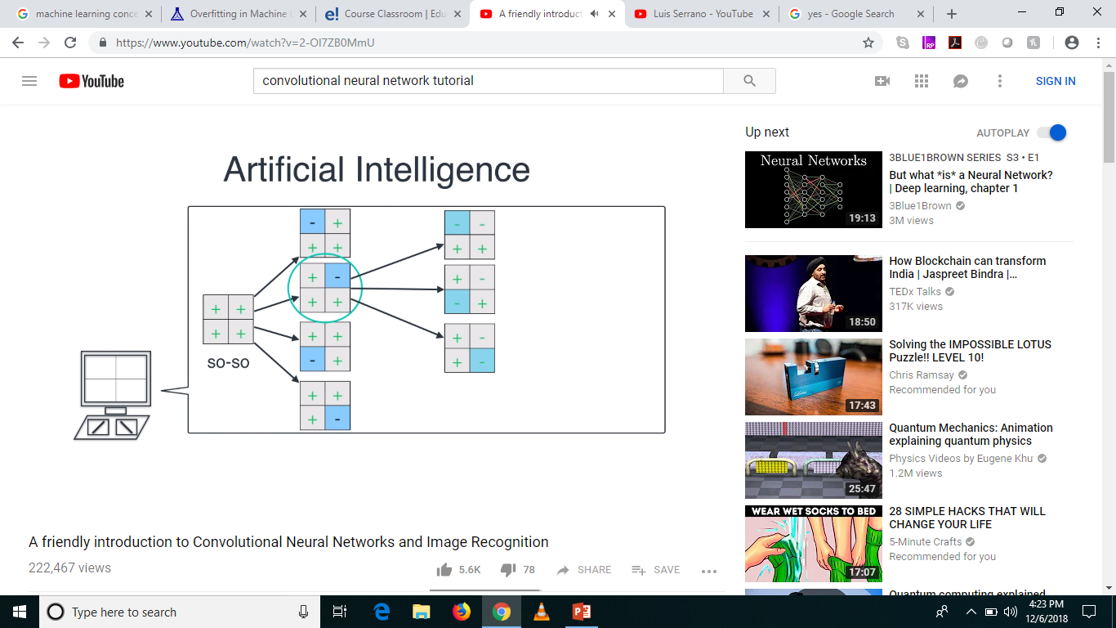


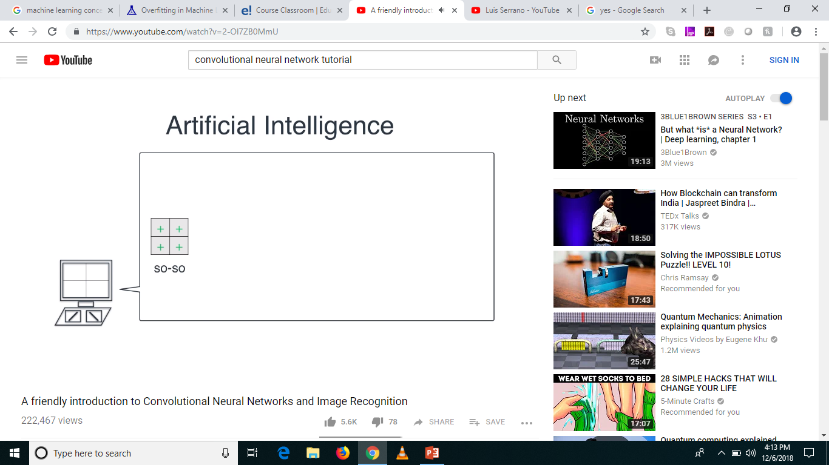


In Reality, its not a Simple World

Slide 17
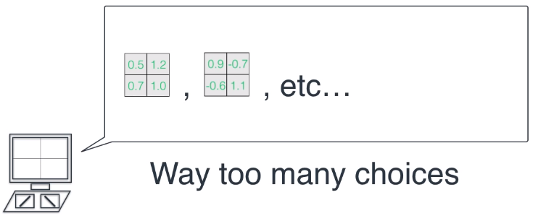
Again, not a Simple World!

Slide 18
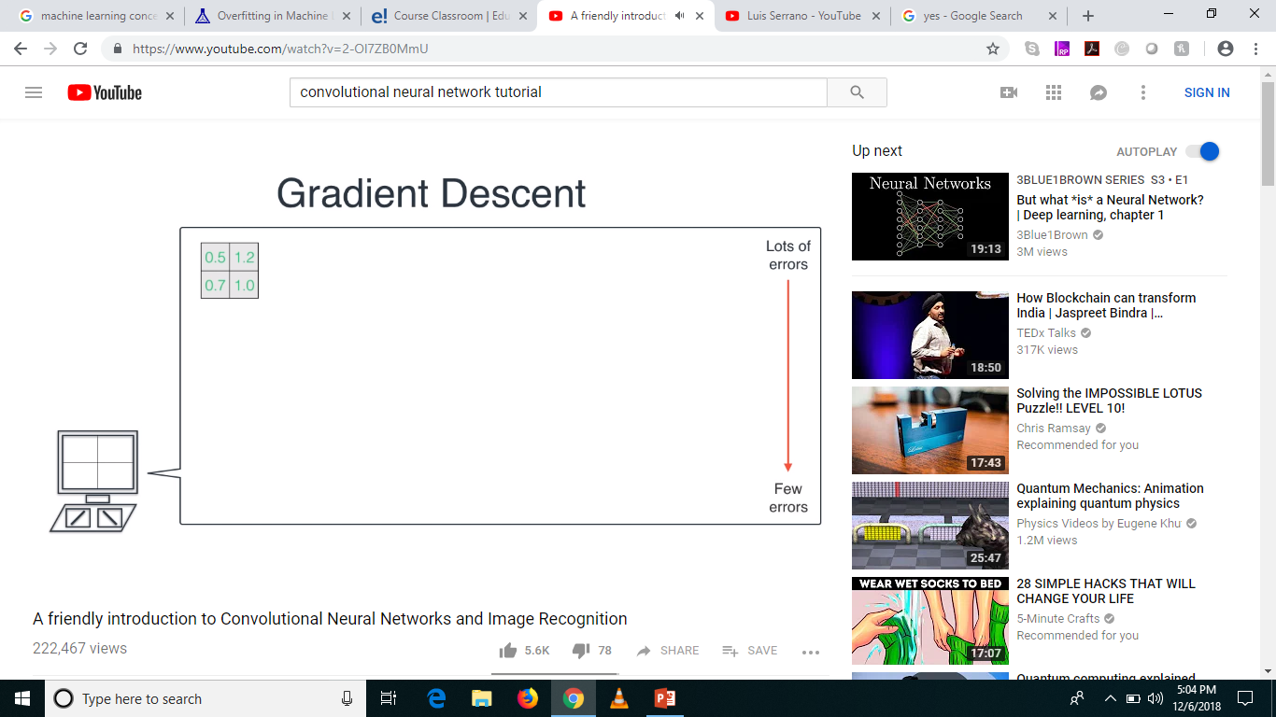
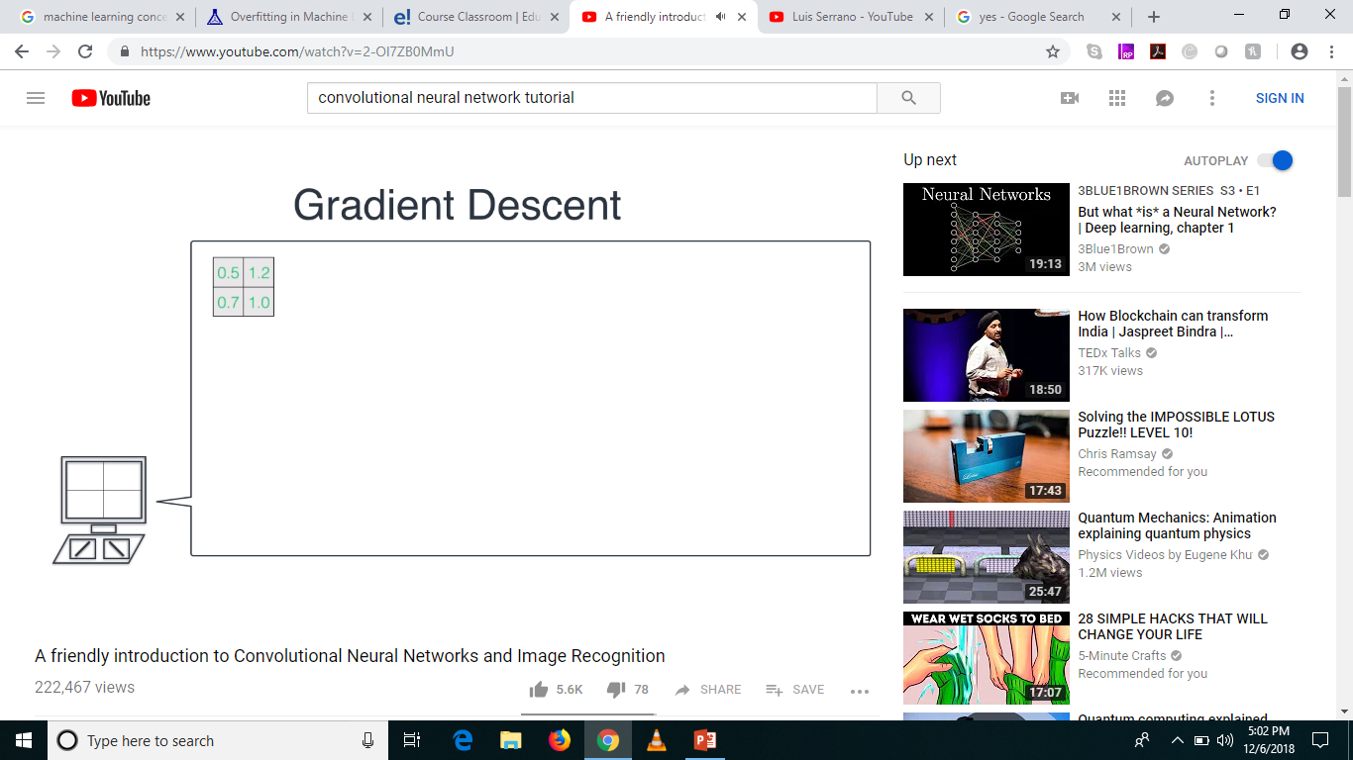
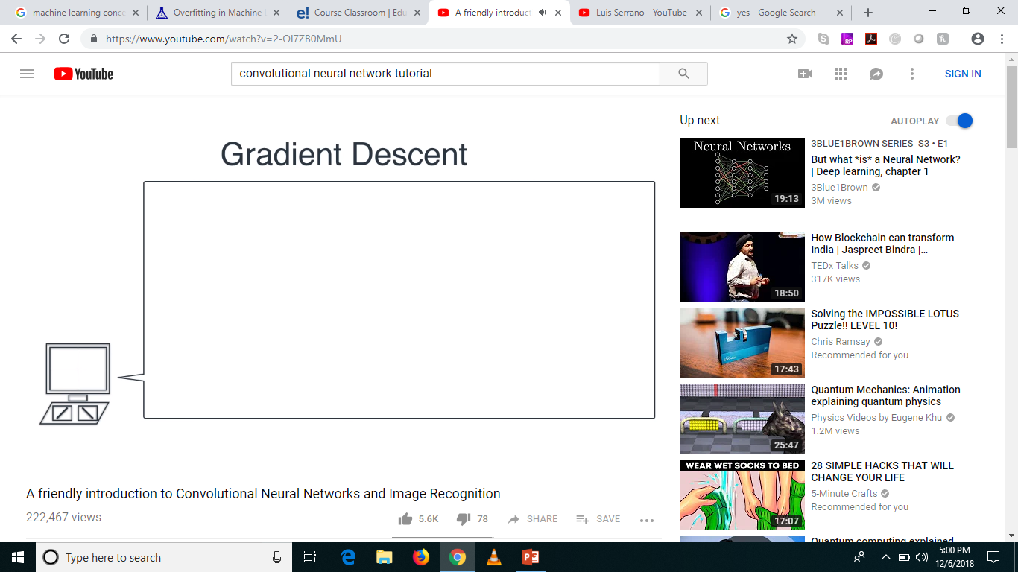



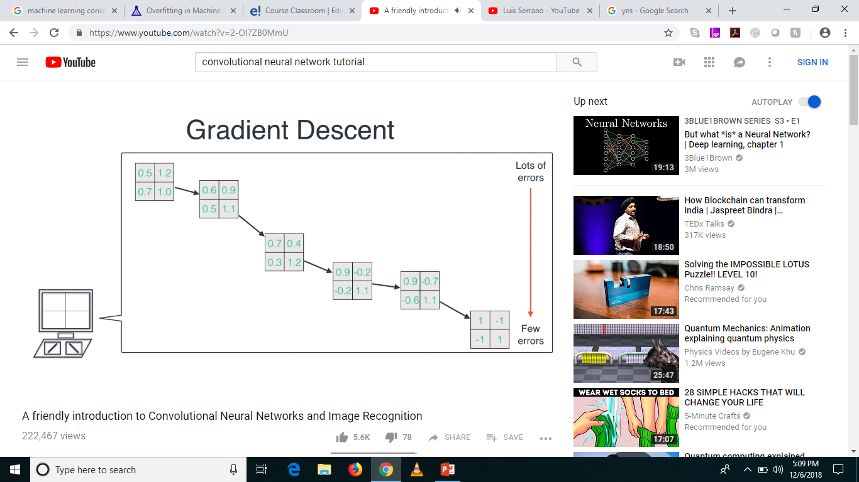

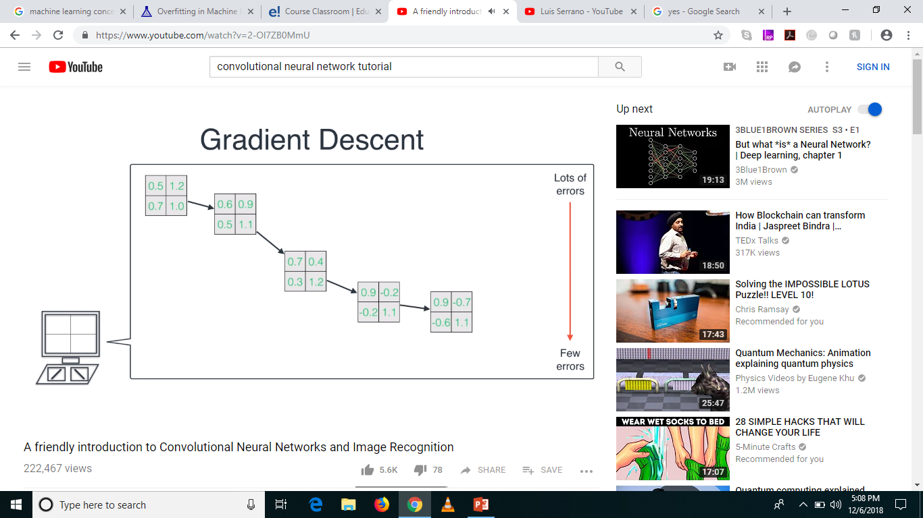
Gradient Descent to the rescue!

Slide 19
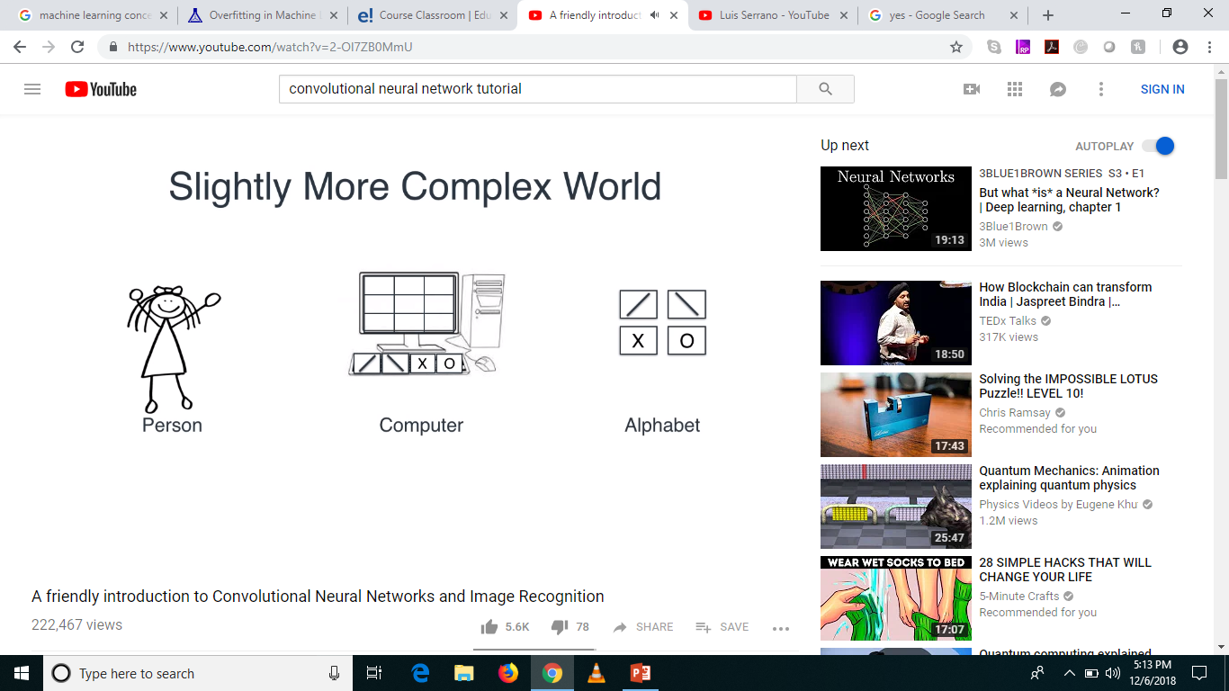
Slightly More Complex World

Slide 20
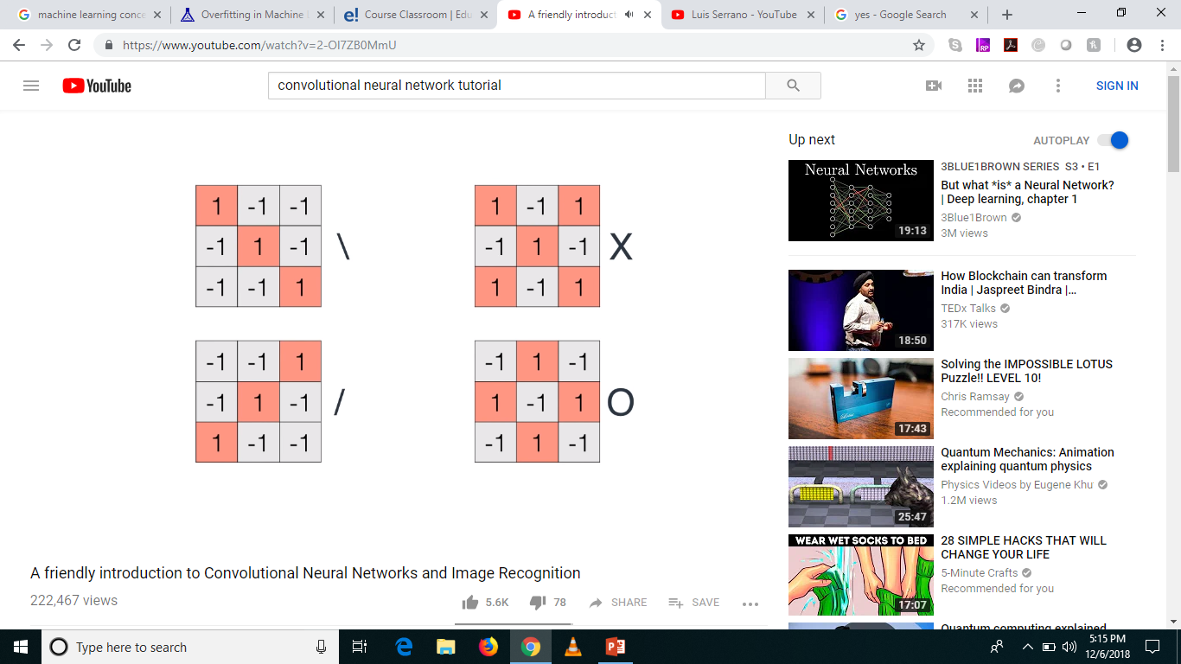
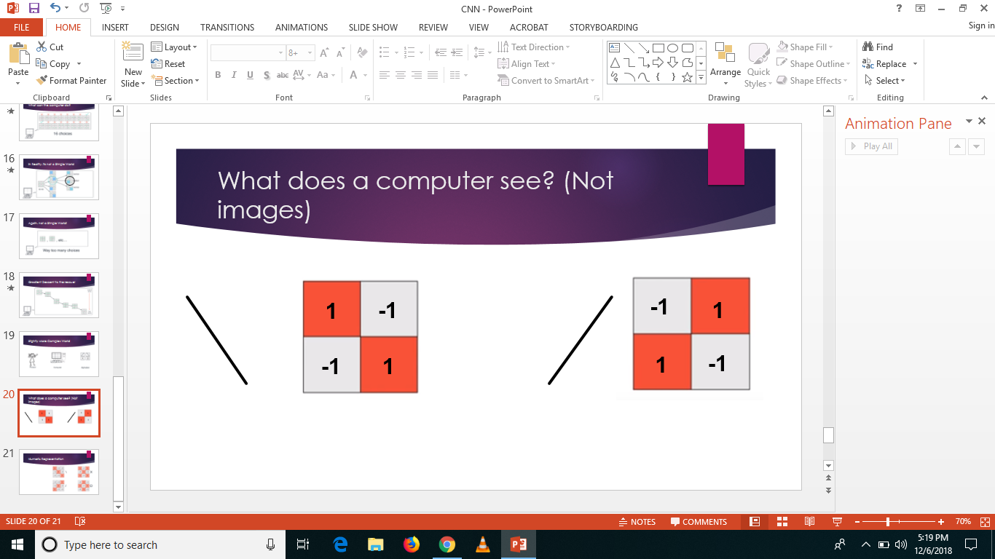
Numeric Representation

Slide 21
Higher Dimensions
Mean higher complexity
More computation difficulty
Simpler the better

Slide 22
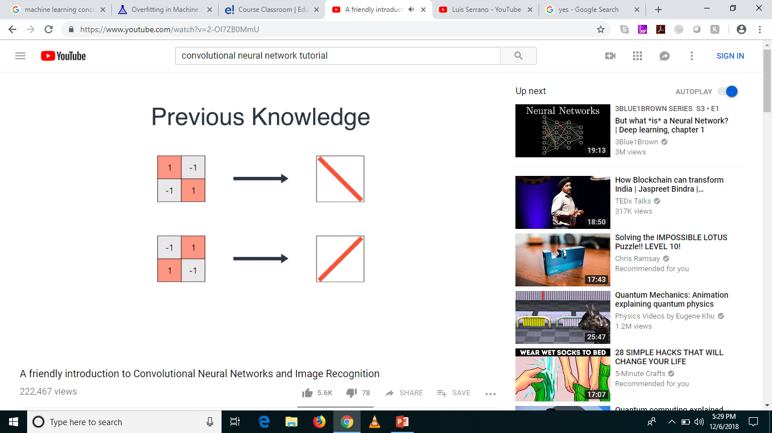
Previous Knowledge

Slide 23
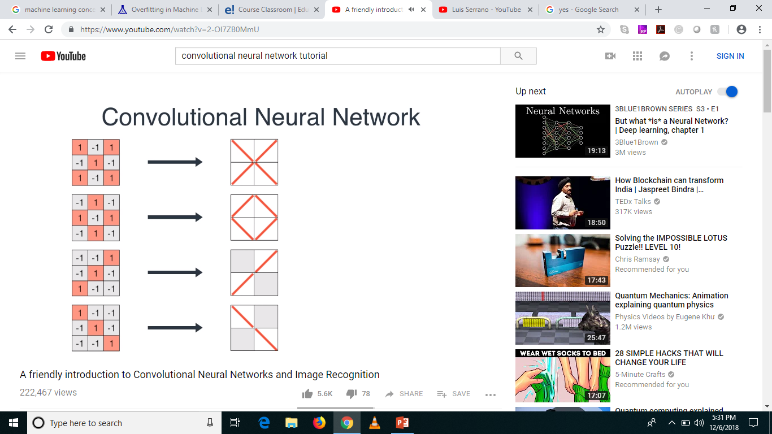
Similarly …

Slide 24
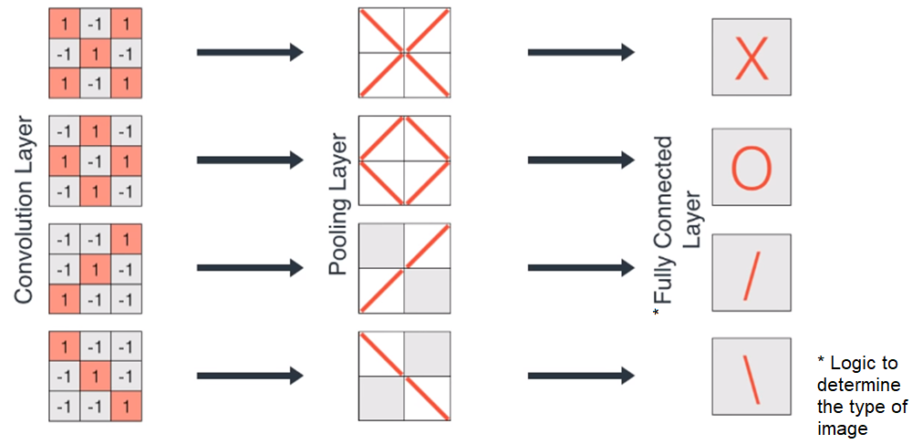
The Layers

Slide 25
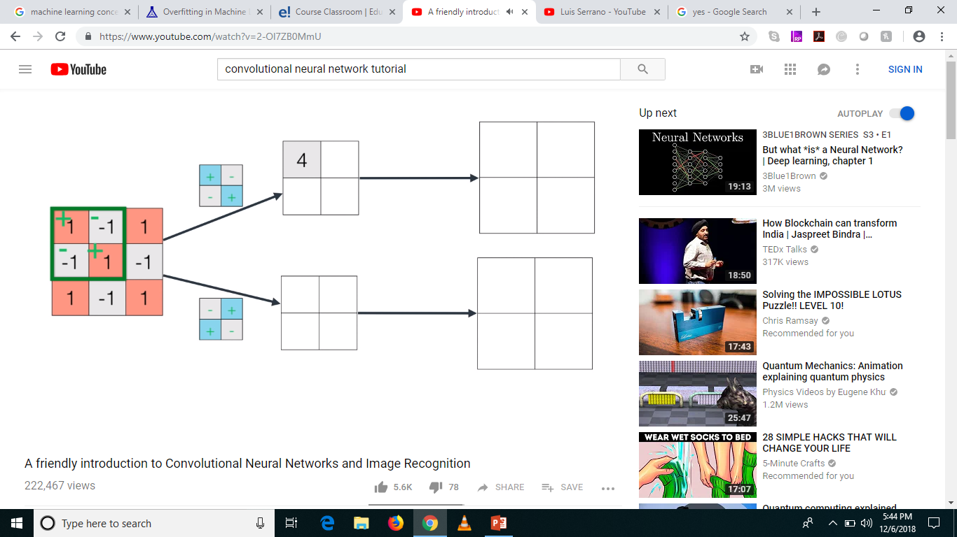
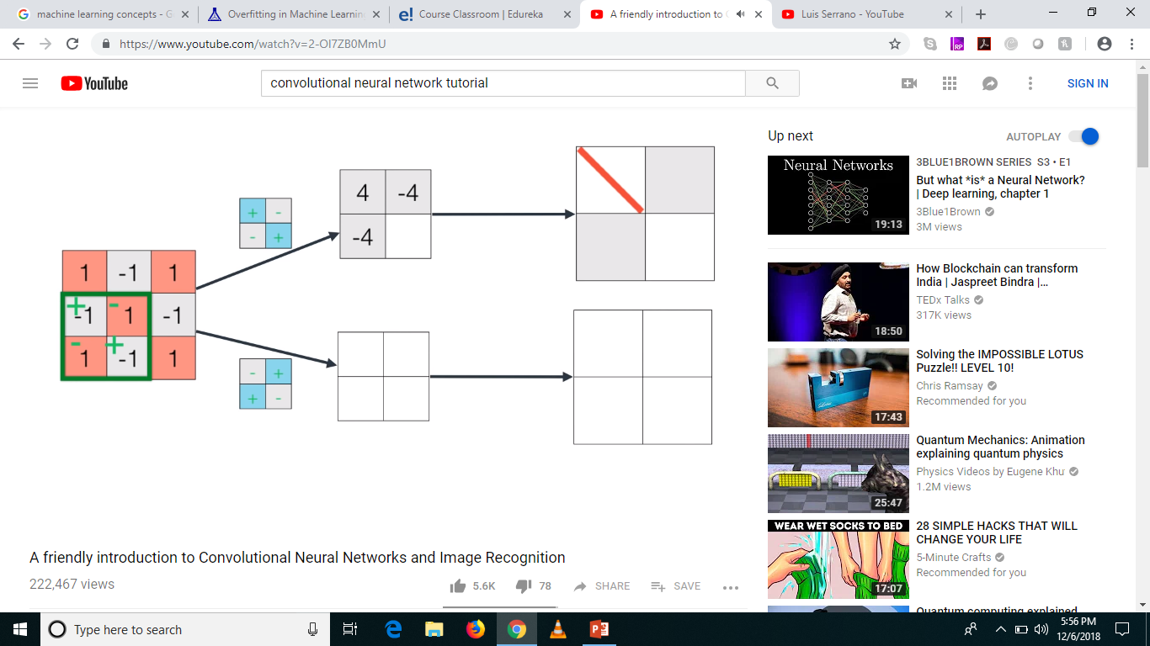
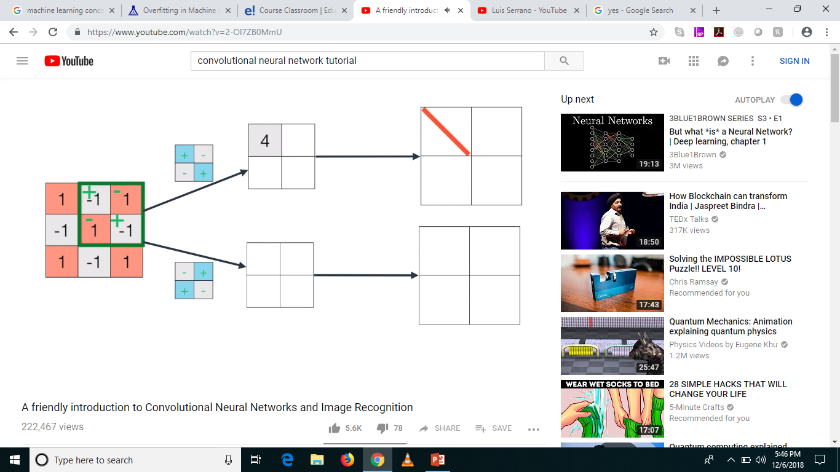
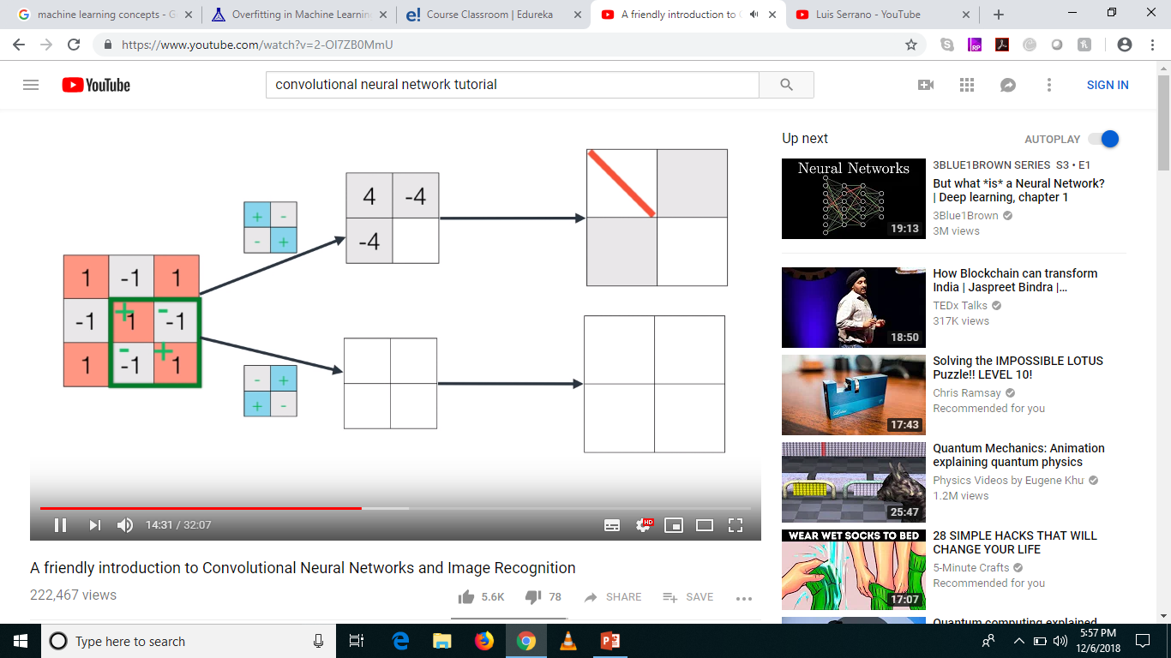
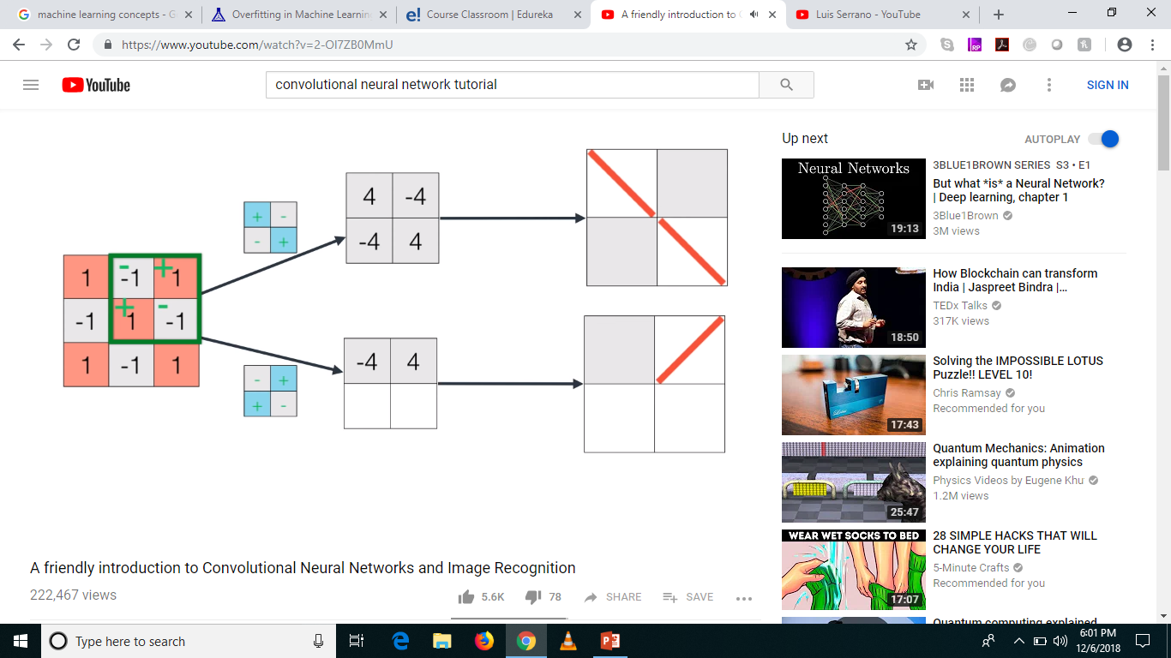



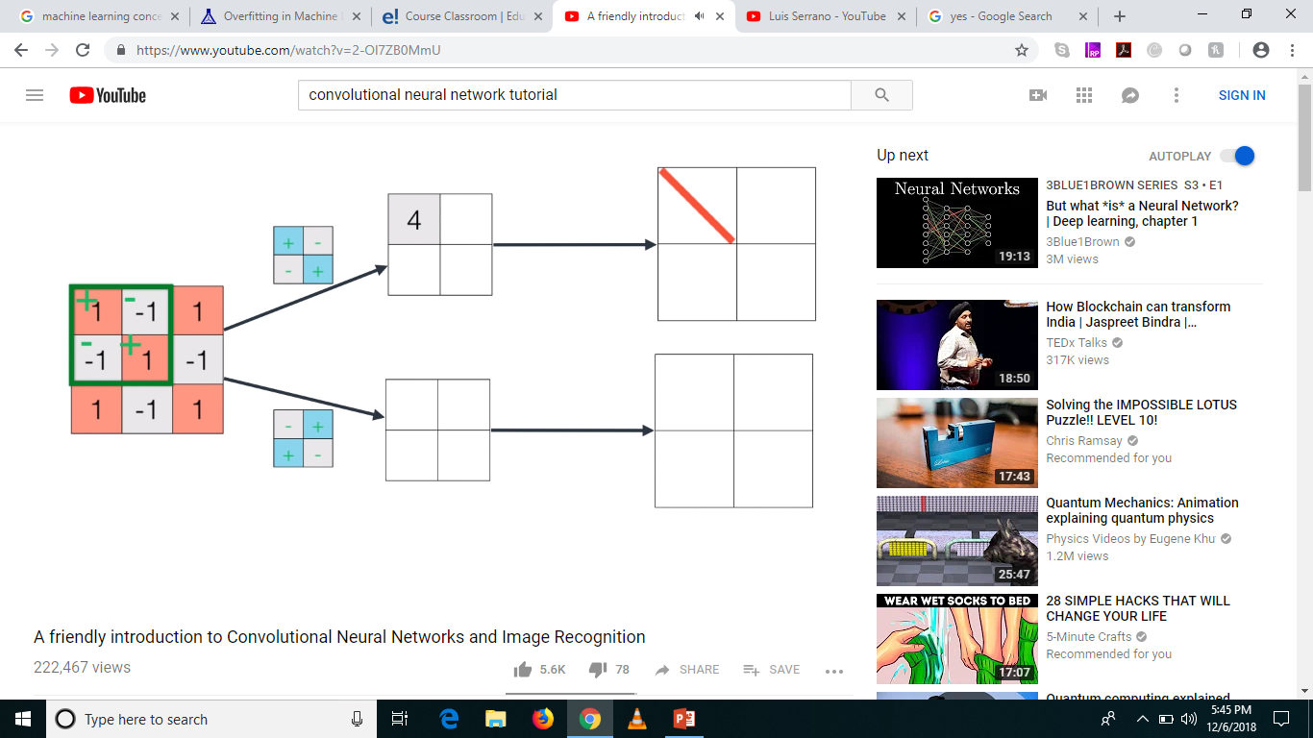

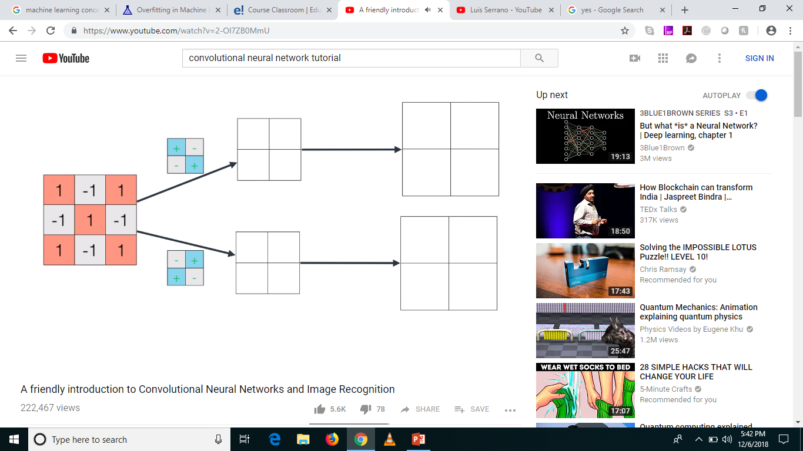
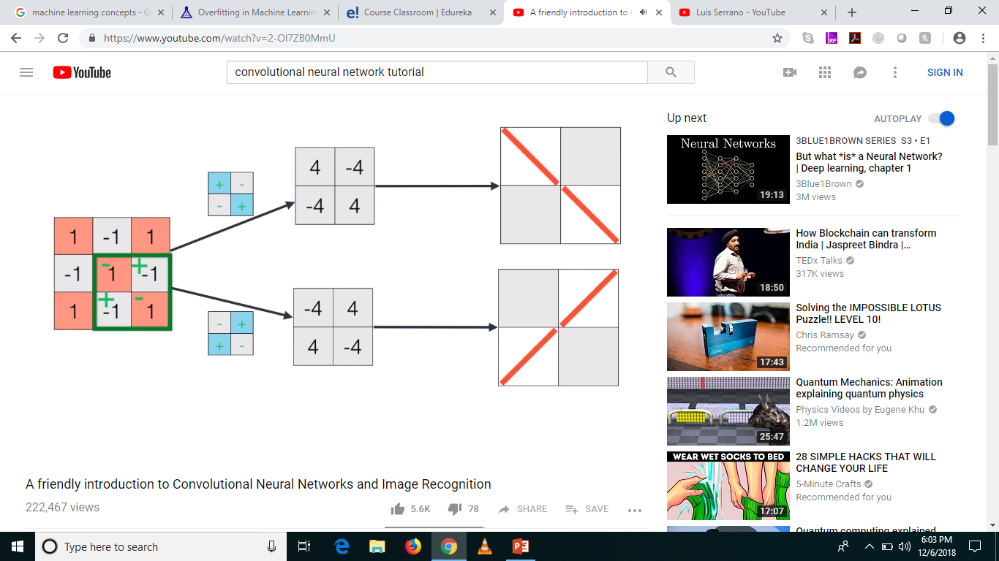


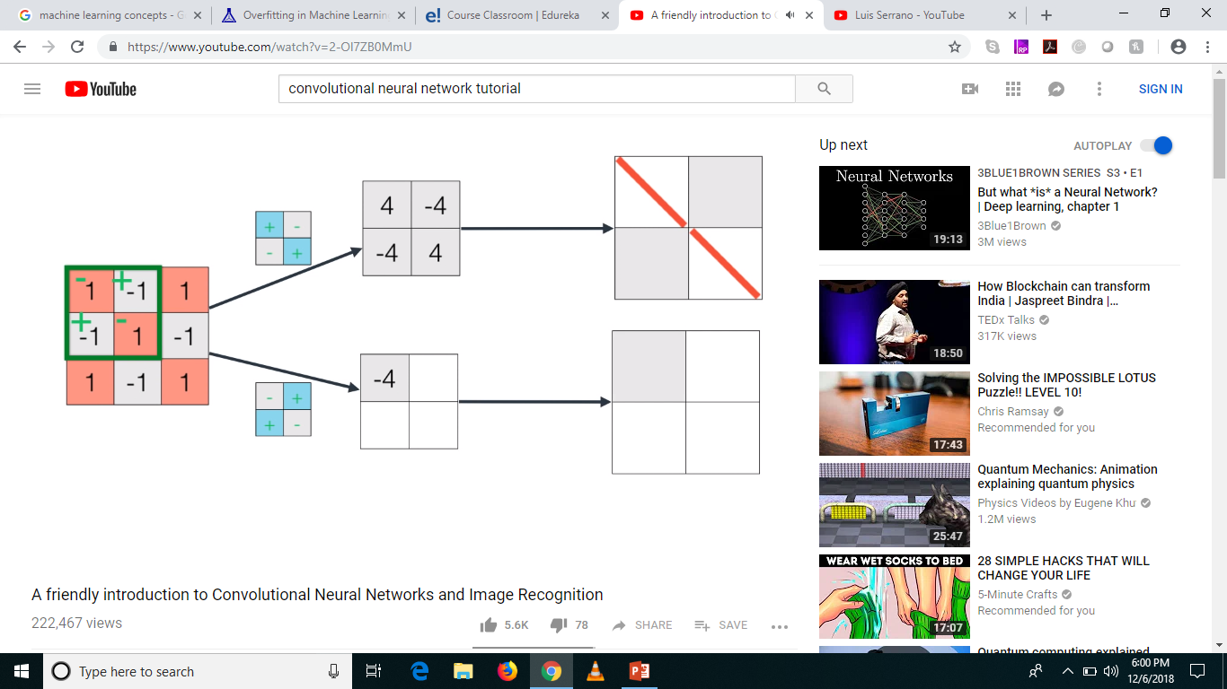
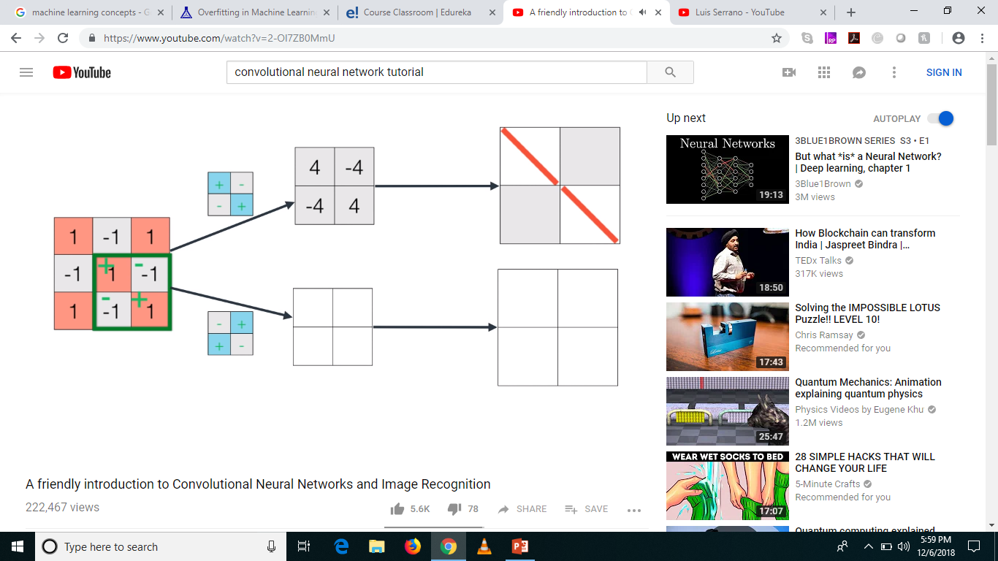

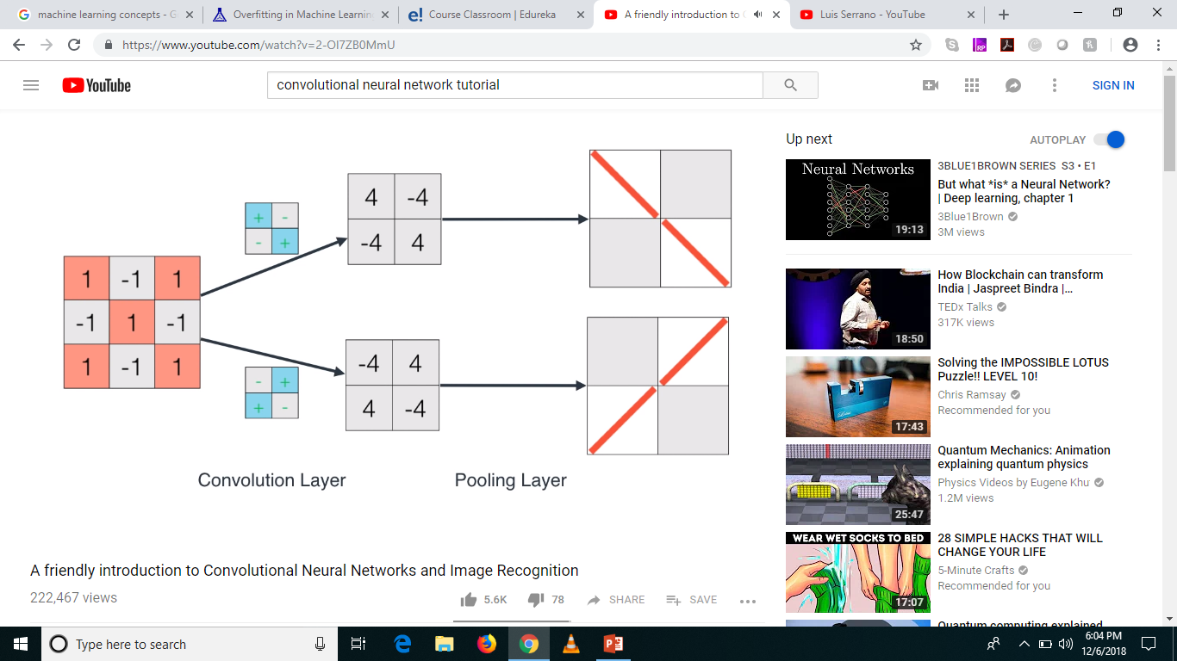
And Action!

Slide 26
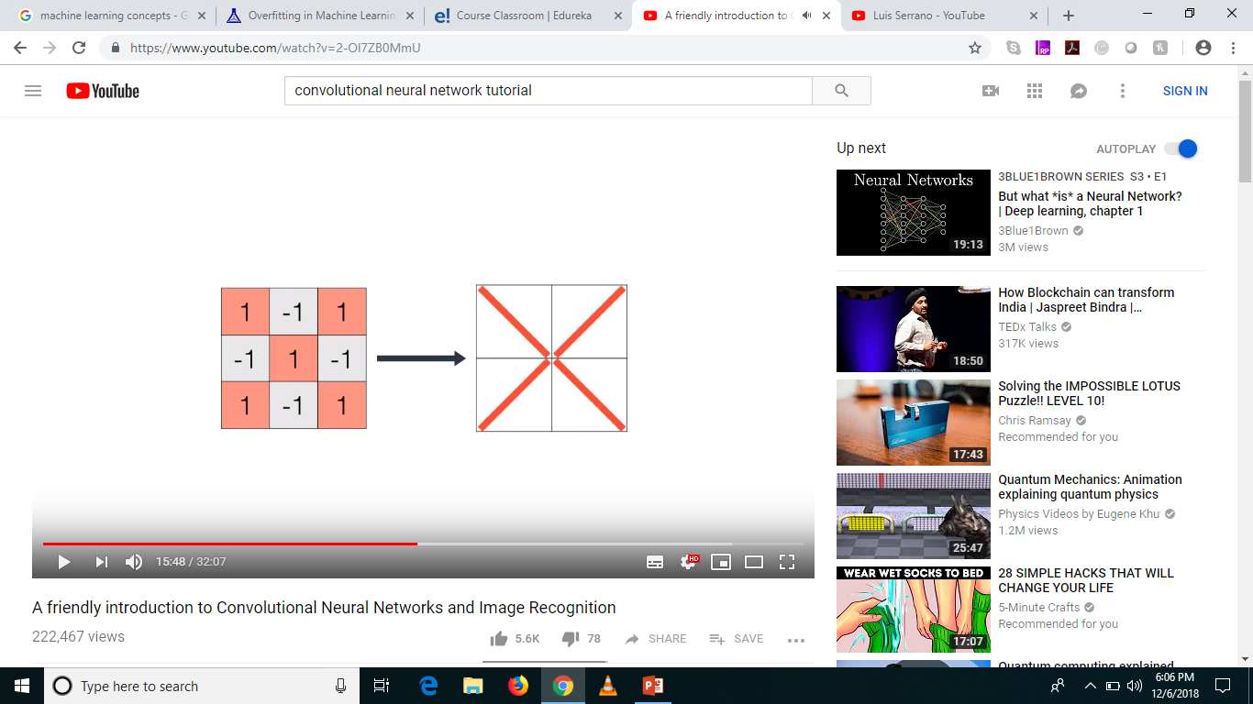
Superimpose

Slide 27
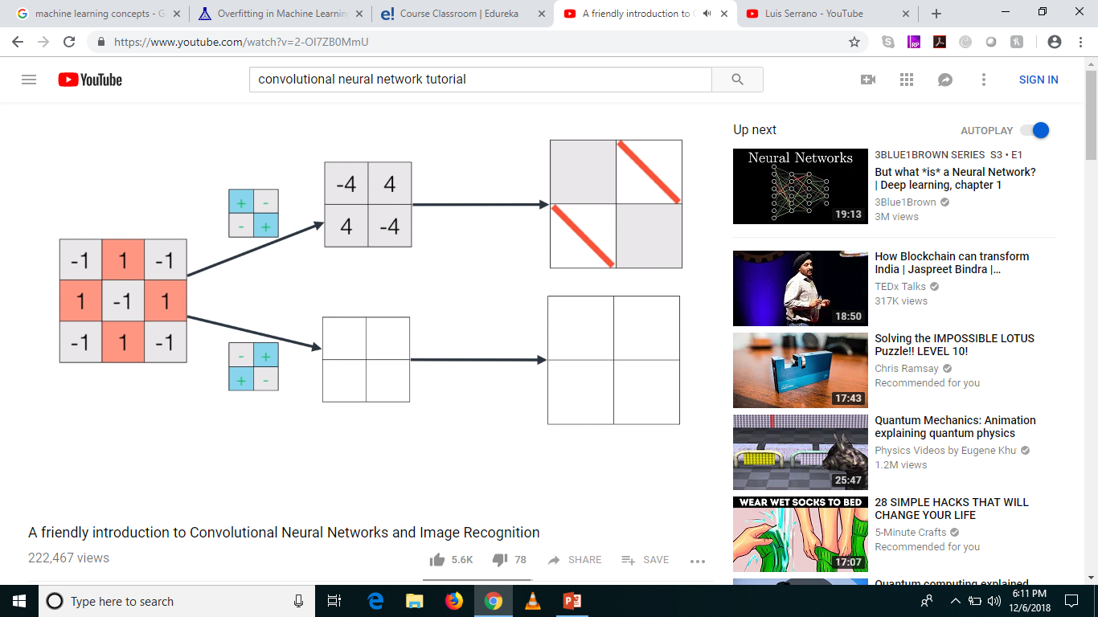
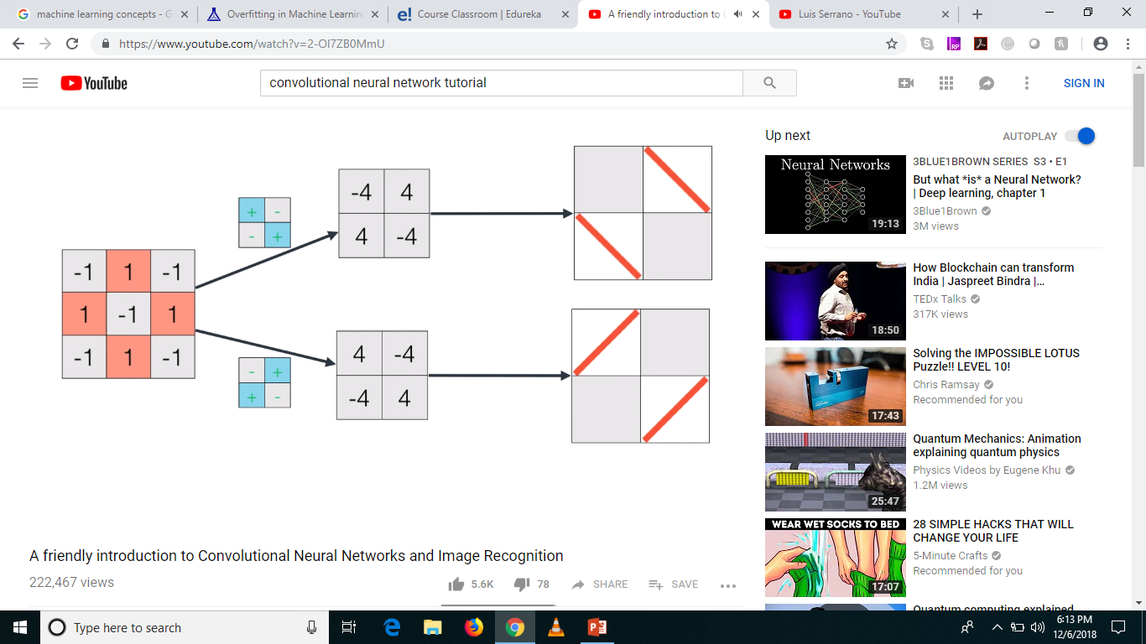
Recap with ‘O’

Slide 28

Superimpose

Slide 29
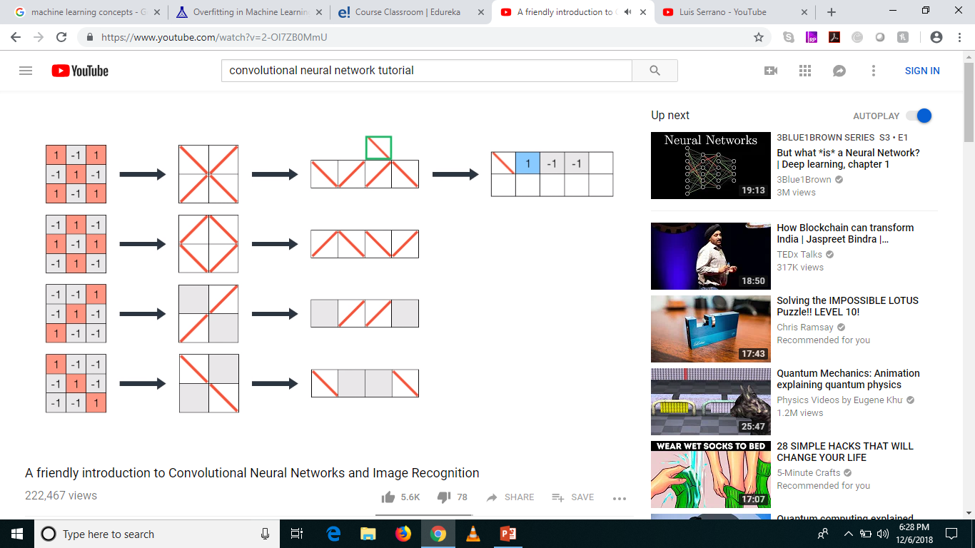




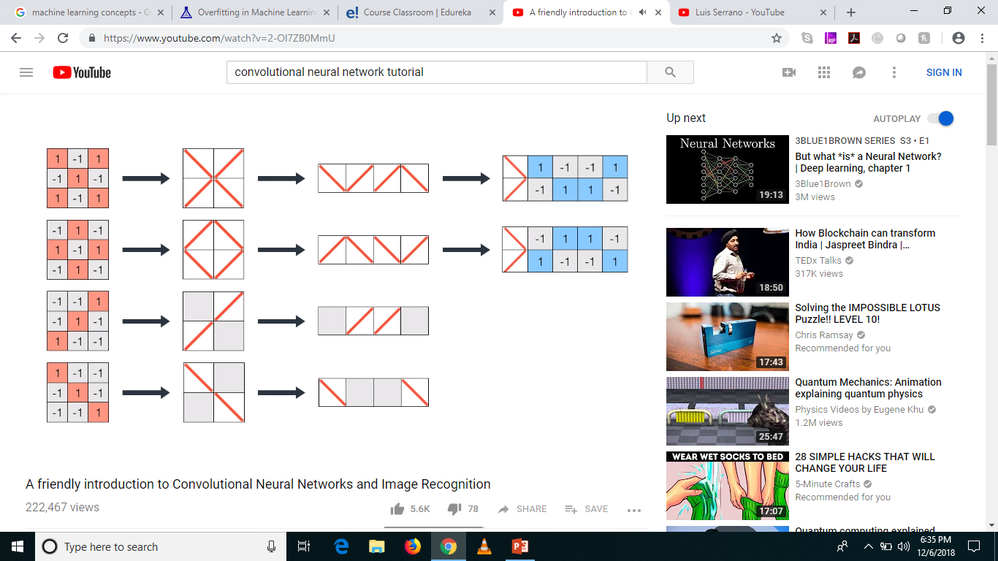



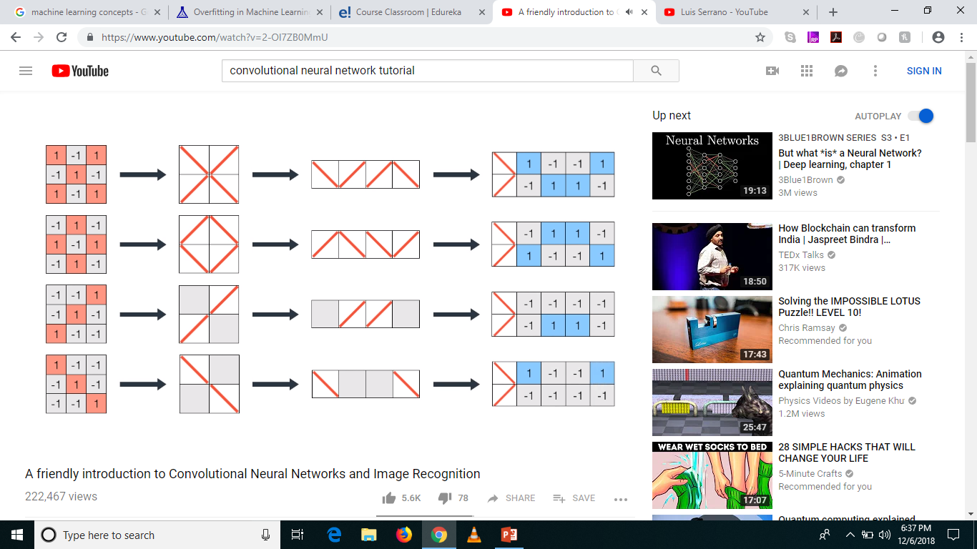
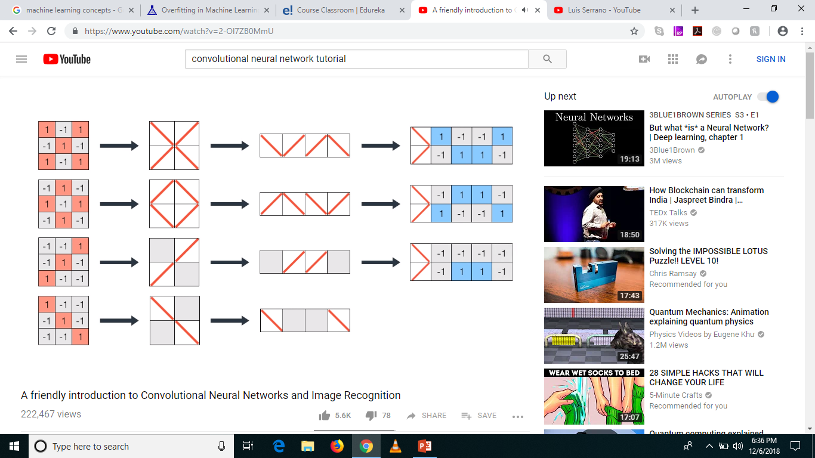
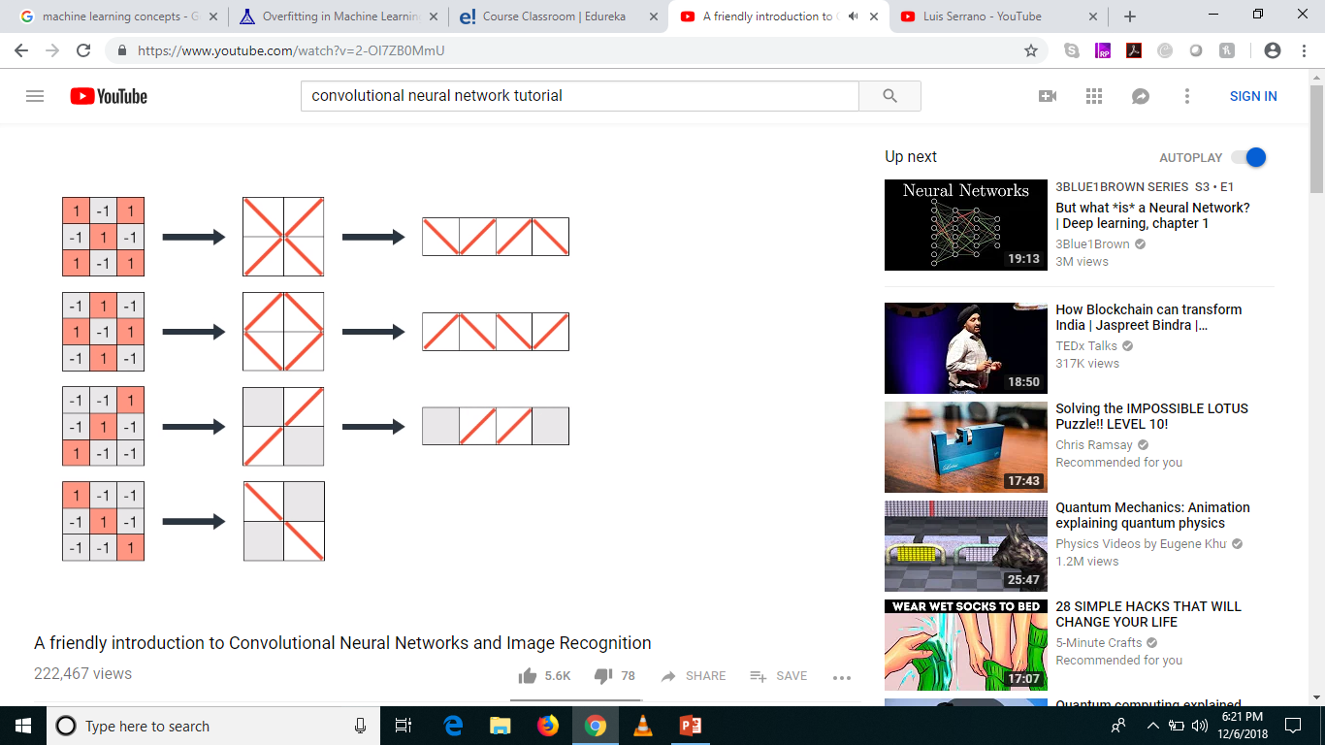
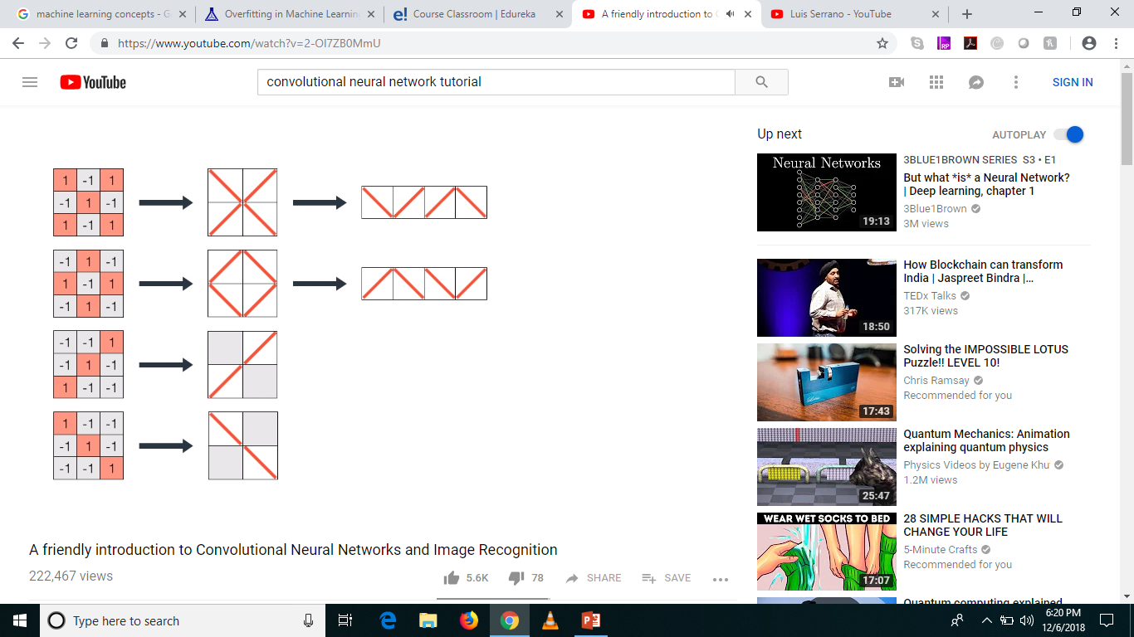
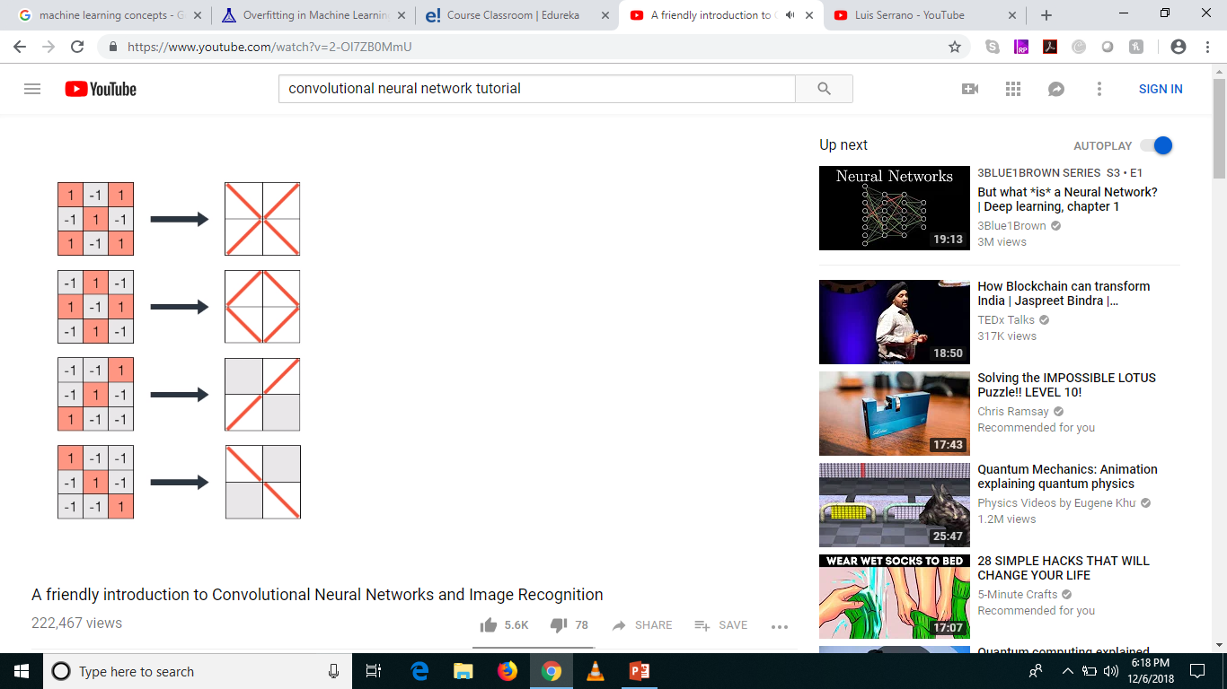

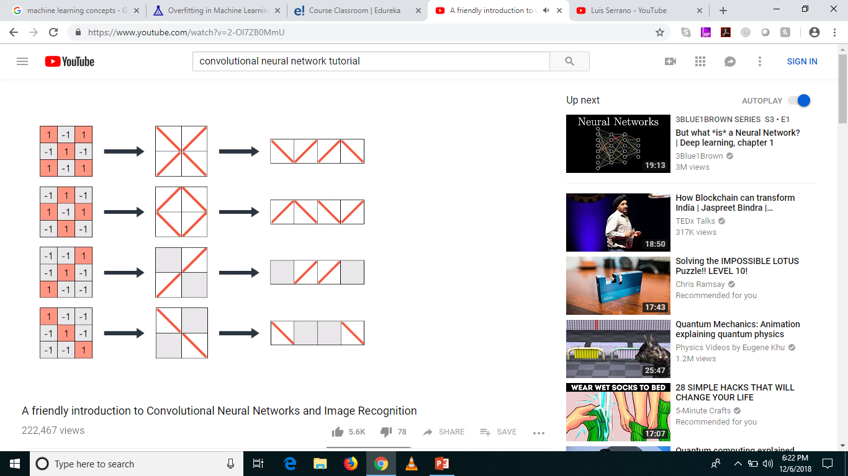

Fully Connected Layer?

Slide 30
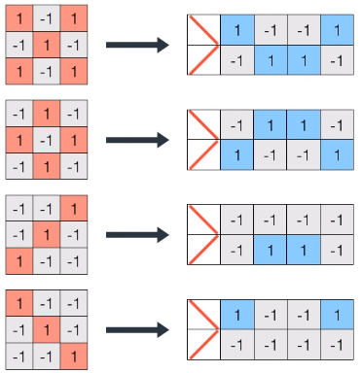
Transformation

Slide 31

Creating Filters

Slide 32




Classifying a new image – ‘X’
8
-8
4
4

Slide 33

Classifying a new image – ‘O’
-8
8
-4
-4

Slide 34

Classifying a new image – ‘/’

Slide 35

Classifying a new image – ‘\’

Slide 36

To Sum Up, what happens in a CNN?

Slide 37





And how does it happen?
Filters for
‘\’
Filters for
‘/’
Convolution Layer
Pooling Layer
Fully Connected Layer

Slide 38

So just for ‘X’

Slide 39


Gradient Descent, Again

Slide 40

Advanced World

Slide 41

To visualize CNN

Slide 42

Recognizing Faces

Slide 43
RNN & LSTM
The Voting Process

Slide 44

Why previous states / input is important

Slide 45
Why previous states / input is important

Slide 46

Sequence

Slide 47

Better Sequence

Slide 48

Missing Sequence

Slide 49

Vectors

Slide 50

Vector for Dinner

Slide 51

Vector for Dinner

Slide 52

Vector Groupings

Slide 53

RNN

Slide 54

RNNs Unwrapped

Slide 55

Writing a book

Slide 56

Vectors for Book

Slide 57
Vectors for Book
0
1
0
0
0

Slide 58


After Training

Slide 59

What does RNN look like?
Activation Function

Slide 60




tanh – Activation Function

Slide 61

Mistakes with RNN

Slide 62



The Solution
Addition
Junction
Multiplication
Junction
Activation Function

Slide 63

Addition Junction (element by element)

Slide 64

Multiplication Junction (element by element)

Slide 65

Multiplication Junction (element by element) Example

Slide 66

Logistic Function

Slide 67


Our RNN becomes LSTM

Slide 68

Complete LSTM

Slide 69









Example – Book

Slide 70
Applications for LSTM
Text (Generation, Translation)
Speech (Translation from Speech to Text and vice versa)
Audio
Video
Robotics (Decision making based on various inputs)
Sequence Identification in Time Series

Slide 71
Autoencoders and RBMs
The Creative Geniuses

Slide 72
Autoencoders
Feature Learning
They encode input, usually by compressing large vectors into smaller vectors that capture their most significant features
They are useful for data compression (dimensionality reduction) as well as data reconstruction for unsupervised learning.
Generative Algorithm vs Discriminative Algorithm

Slide 73

What?

Slide 74

Seriously?

Slide 75

What else?

Slide 76

And?

Slide 77

And?

Slide 78
Restricted Boltzmann Machine
Invented by Geoffery Hinton – University of Montreal
Algorithm for Feature Learning
Music, Text, Classification
Latent Features Only

Slide 79

Scenarios

Slide 80

Scenarios

Slide 81

Scenarios

Slide 82

What do they look like?

Slide 83

What do they do?

Slide 84



Understanding their operations

Slide 85

Reconstruction

Slide 86


Different Questions from NN
NN – What operations should I do to convert an input into output?
RBM – Forward - Given these pixels, should my weights send a stronger signal to the elephant node or the dog node?
RBM – Backward - Given an elephant, which distribution of pixels should I expect?

Slide 87

Stacked RBMs

Slide 88

DBN

Slide 89

Object Detection

Slide 90

Technically

Slide 91

Technically

Slide 92

Technically

Slide 93

Technically

Slide 94

Technically

Slide 95

Sample – on youtube url

Slide 96

Sample – behind the scenes

Slide 97

How does Netflix Recommend Movies?

Slide 98


How does Netflix Recommend Movies?

Slide 99

How does Netflix Recommend Movies?

Slide 100

How does Netflix Recommend Movies?

Slide 101

How does Netflix Recommend Movies?

Slide 102


How does Netflix Recommend Movies?

Slide 103

How does Netflix Recommend Movies?

Slide 104

How does Netflix Recommend Movies?

Slide 105

How to determine ratings?

Slide 106

Movie can have many features

Slide 107

Ratings Calculations?

Slide 108

Ratings Calculations

Slide 109

Ratings Calculations

Slide 110

Ratings Calculations

Slide 111

Ratings Calculations

Slide 112

Ratings Calculations

Slide 113

Ratings Calculations

Slide 114

Ratings Calculations

Slide 115

Matrix Factorization

Slide 116

Matrix Factorization

Slide 117

Matrix Factorization

Slide 118

Matrix Factorization

Slide 119

How to find the right factorization values?

Slide 120

How to find the right factorization values?

Slide 121

How to find the right factorization?

Slide 122

How to find the right factorization values?

Slide 123

How to find the right factorization values?

Slide 124

How to find the right factorization values?

Slide 125

How to find the right factorization values?

Slide 126



Predicting Ratings

Slide 127

Don’t be a jack of all trades, know your area
Exact meaning of jargons – Know it!
People like to complicate things unnecessarily – uncomplicate it!
Use common sense
The three pillars of perfect knowledge -
What
Why
How

Slide 128
Differentiate!
Does this project really require Data Science?
RPA Vs. AI
Ask yourself – Can this be done by a high school graduate?
The traditional programming attitude!
Ask yourself – how does a human baby learn?

Slide 129
Let’s see some code?
Thank you!

